Slide 1
Concurrent Operation of Wireless Power Transfer Based Contactless Slip Ring and Motor Drive System with a Single Converter
Enes Ayaz
M.Sc. Thesis Defense
Middle East Technical University (METU), Department of Electrical and Electronics Engineering Ankara, TURKEY
September 2022
Notes:
Dear professors and collagues

Slide 2
Outline
Aim of Study
Wireless Power Transfer System Basics
Theory Of Operations
Implementation for DC Motor
Implementation for AC Motor
Implementation for field excitation
Conclusion

Slide 3
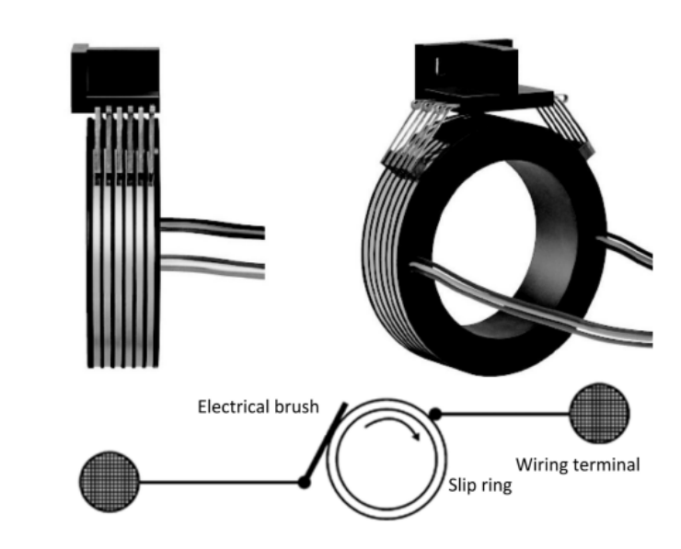
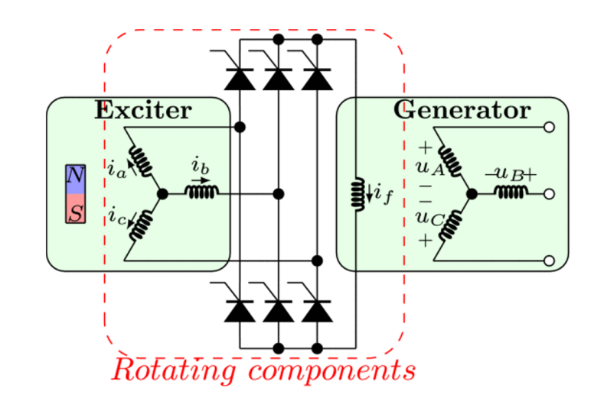
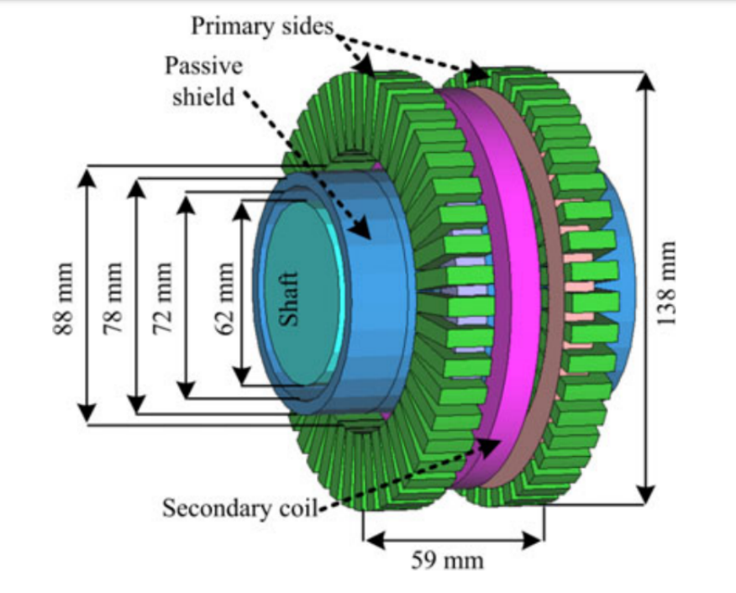
Power Transfer to Rotating Frames
Slip Rings
Brushless Exciter
Contactless
Slip Rings

Slide 4
Power Transfer to Rotating Frames
 | Slip Rings | Brushless Exciters | Contactless Slip Rings
Reliability | - | + | +
Maintenance | - | + | +
Simplicity | + | + | -
Speed Independency | + | - | +
Cost Effectivity | + | + | -
Efficiency | + | - | +

Slide 5
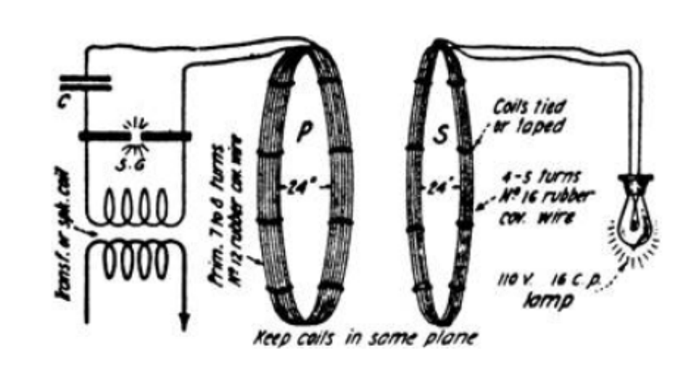
Wireless Power Transfer Based Contactless Slip Rings
 | Inductive Power Transfer | Capacitive Power Transfer
Transfer Type | Varying MF | Varying EF
Power Ratings | High | Low
Frequencies | Low | High
Efficiency | High | High
Distance | Moderate | Low
Tesla’s WPT System

Slide 6
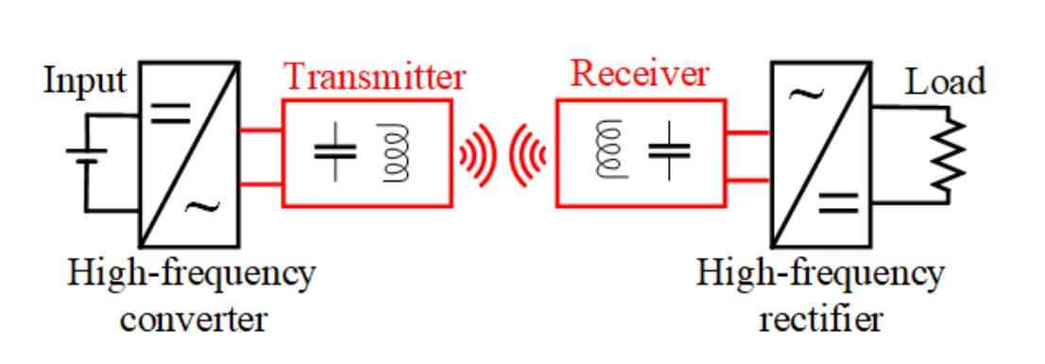
Inductive Power Transfer
DC/AC converter
Compensation Circuits
Transmitter/Receiver Coils
AC/DC Rectifiers

Slide 7
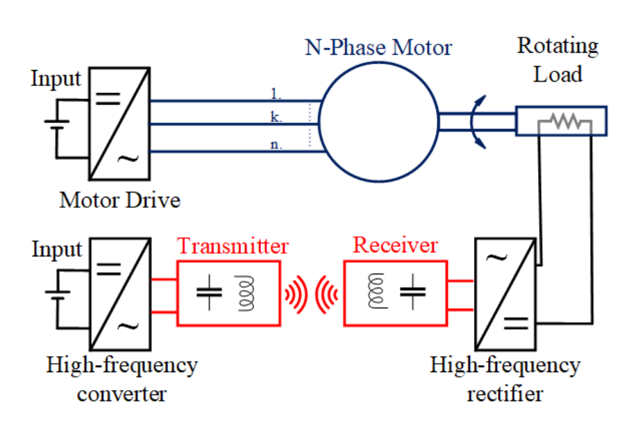
Conventional Inductive Power Transfer Based Contactless Slip Ring
Two converters:
To drive the motor
To excite the Tx coil
Motor → attenuated in motor current
The motor drive → generating low and high frequency
Motor → used to drive
The WPT converter → generating high frequency
The WPT system →behaves like band-pass filter

Slide 8
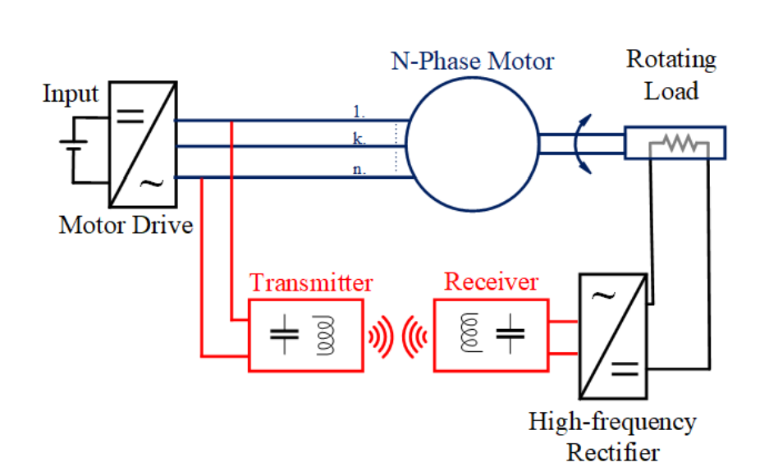
Proposed Inductive Power Transfer Based Contactless Slip Ring
The motor drive → generating high frequency
combining
The WPT system →behaves like band-pass filter
eliminating
The WPT converter → generating high frequency

Slide 9
Proposed Inductive Power Transfer Based Contactless Slip Ring
 | Conventional Contactless Slip Ring | Proposed Contactless Slip Rings
Reliability | + | +
Maintenance | + | +
Simplicity | - | +
Speed Independency | + | +
Cost Effectivity | - | +
Efficiency | + | +

Slide 10
Outline
Aim of Study
Inductive Power Transfer System Basics
Theory Of Operations
Implementation for DC Motor
Implementation for AC Motor
Implementation for field excitation
Conclusion

Slide 11
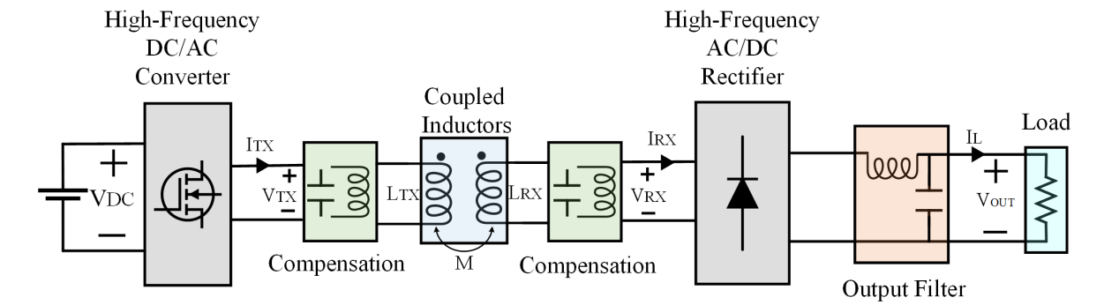
Inductive Power Transfer System

Slide 12
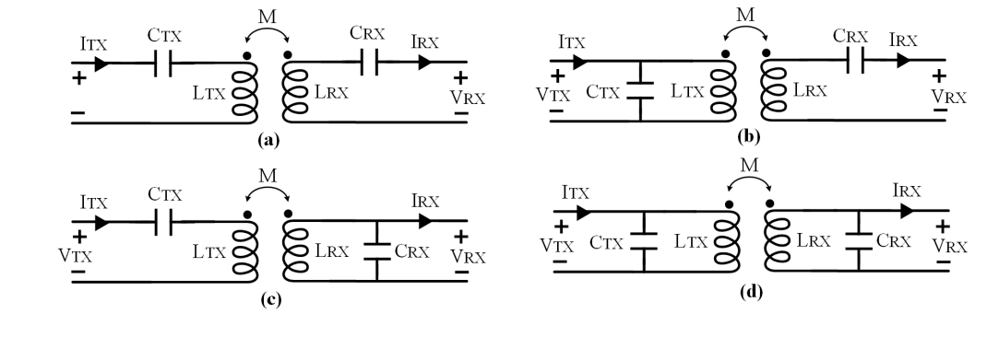
Compensation Topologies
Series-Series Compensation
Source Type | Voltage Source
Resonant frequency | Load Independent
Resonant frequency | Coupling Independent
No load operation | Short Circuit
Capacitor Size | Large
a) Series-series
b) Parallel-series
c) Series-parallel
d) Parallel-parallel

Slide 13
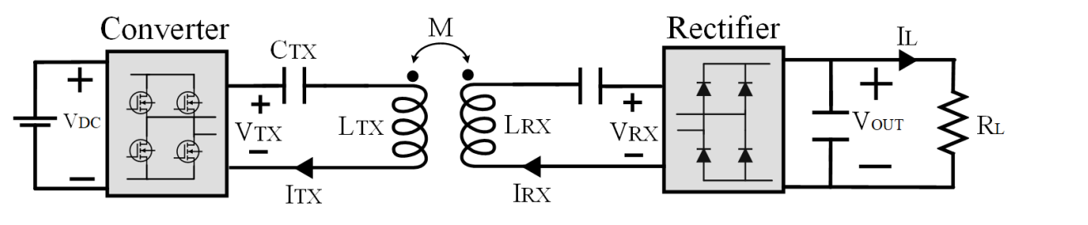
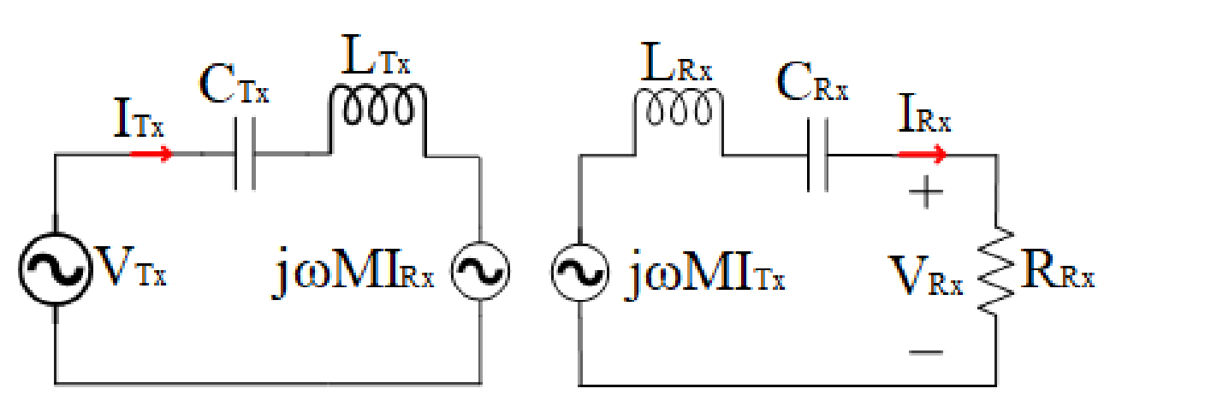
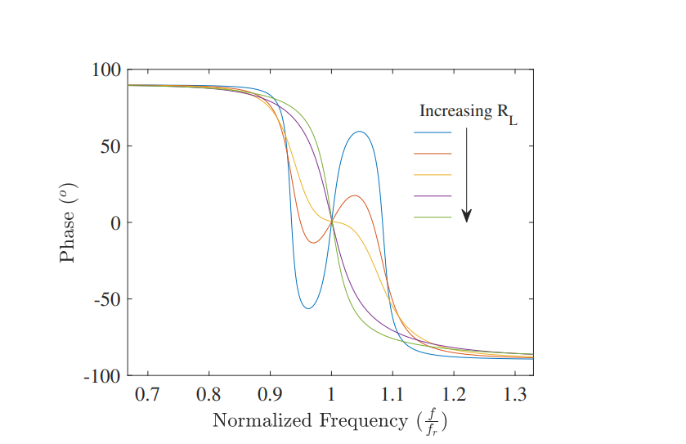
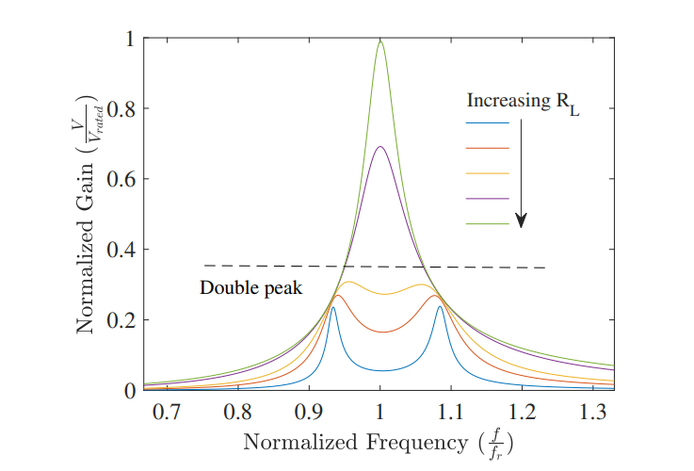
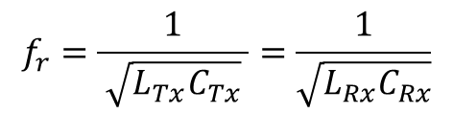

Series-Series IPT System
CRX
Single-peak band pass filter
First Harmonic Approach (FHA)
Phase < 0 → Inductive region
$f_{op}>f_{r}$→ Inductive region
$$f_{r}=\frac{1}{ \sqrt{L_{Tx}C_{Tx}} }=\frac{1}{\sqrt{L_{Rx}C_{Rx}}}$$

Slide 14
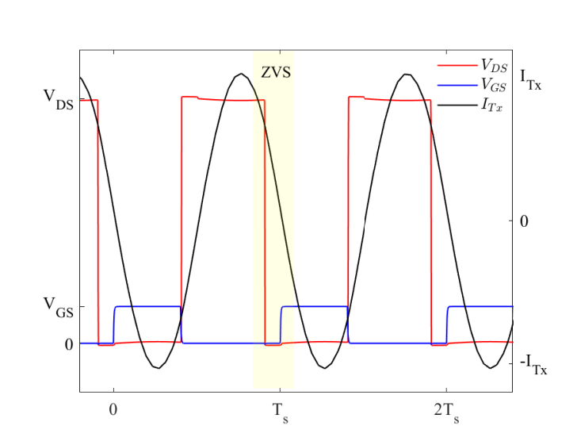
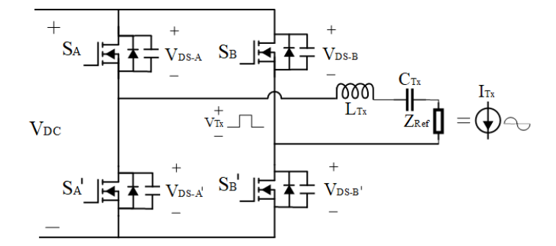
Zero Voltage Switching
Inductive region → The capacitance of the switches discharges by the load current during dead time.

Slide 15
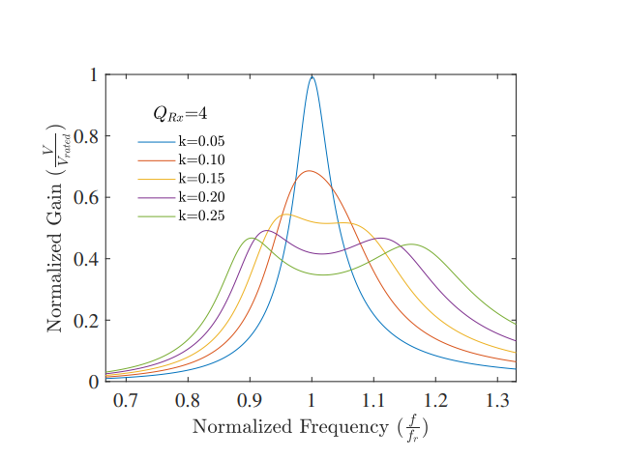
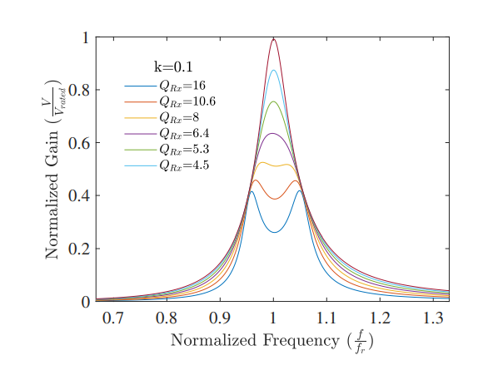
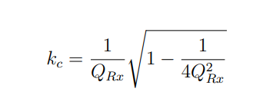
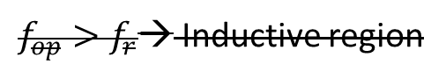
Bifurcation Phenomenon
Double-peak
$f_{op}>f_{r}$→ Inductive region
Making control difficult
Decreasing efficiency

Slide 16
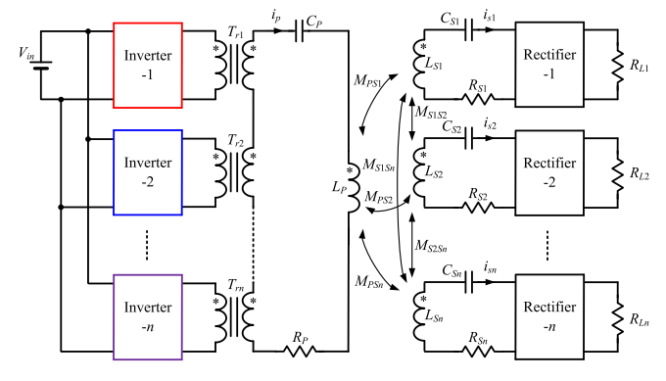
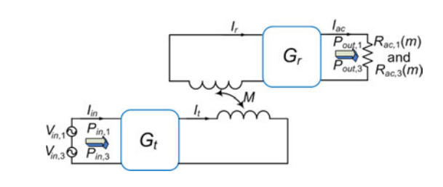
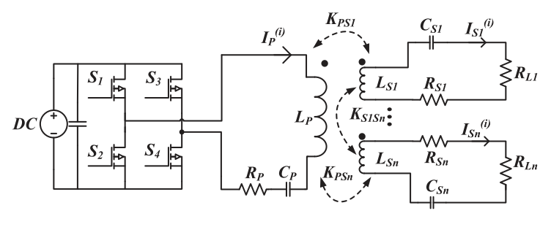
Multifrequency IPT Systems
Aims:
To Increase power
To reduce switching components
To increase DC-link utilization rate
Operating in more than one standards
Studies:
Multi-converter and multi-resonant
Single-converter and multi resonant
Single-converter and multi-load

Slide 17
Outline
Aim of Study
Inductive Power Transfer System Basics
Theory Of Operations
Implementation for DC Motor
Implementation for AC Motor
Implementation for field excitation
Conclusion

Slide 18
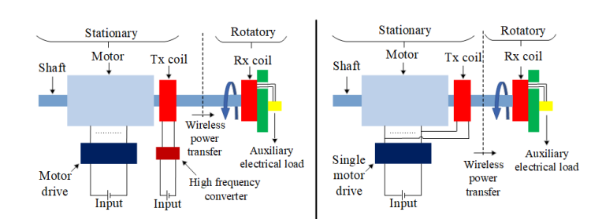
The Proposed Contactless Slip Ring Method
Conventional System
Proposed System
Motor Drives
DC motor drive
AC motor drive

Slide 19
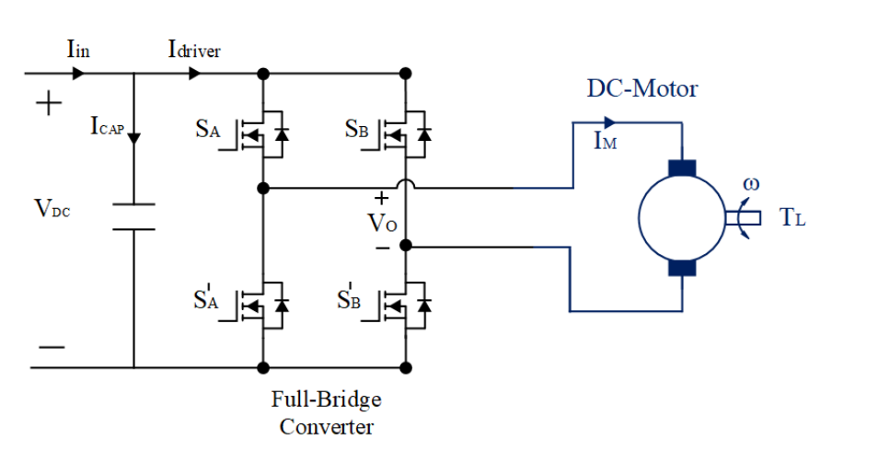
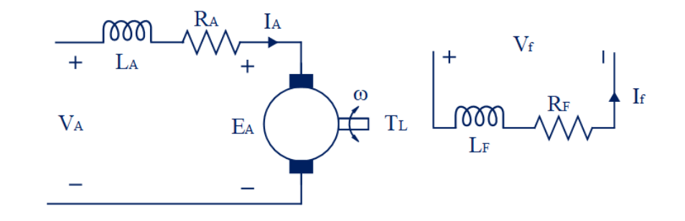
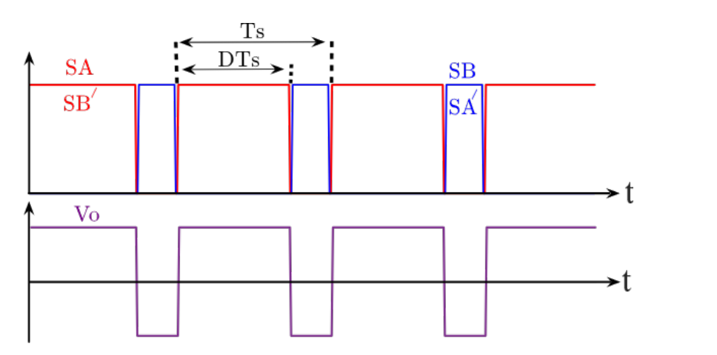
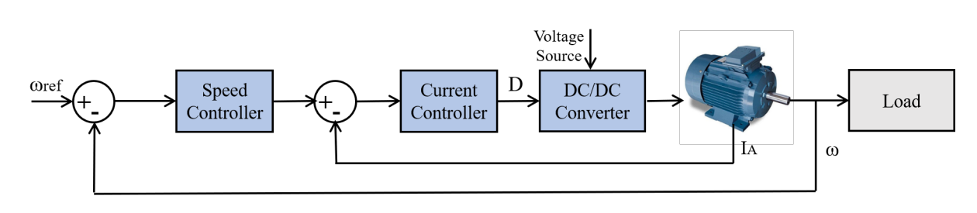
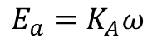
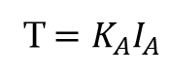
DC Motor Drives
Varying
armature voltage
Constant field
excitation
$$E_{a}=K_{A}ω$$
T$=K_{A}I_{A}$
Control diagram

Slide 20
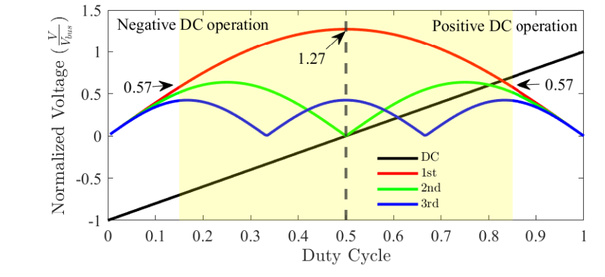
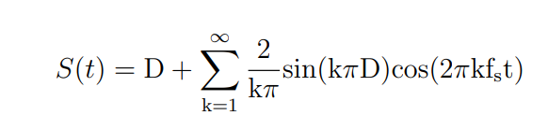
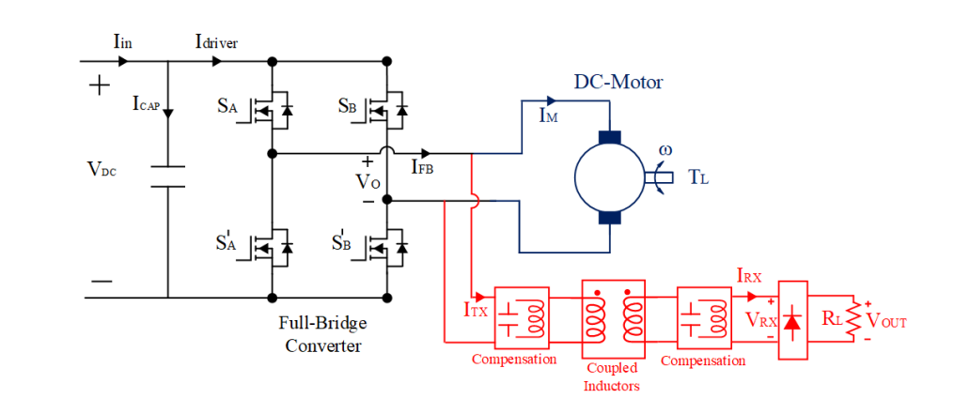
Proposed Modulation Technique

Slide 21
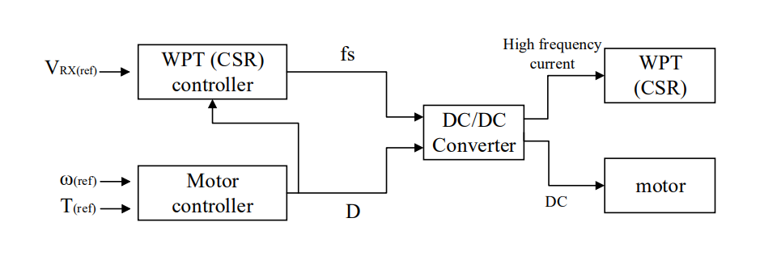
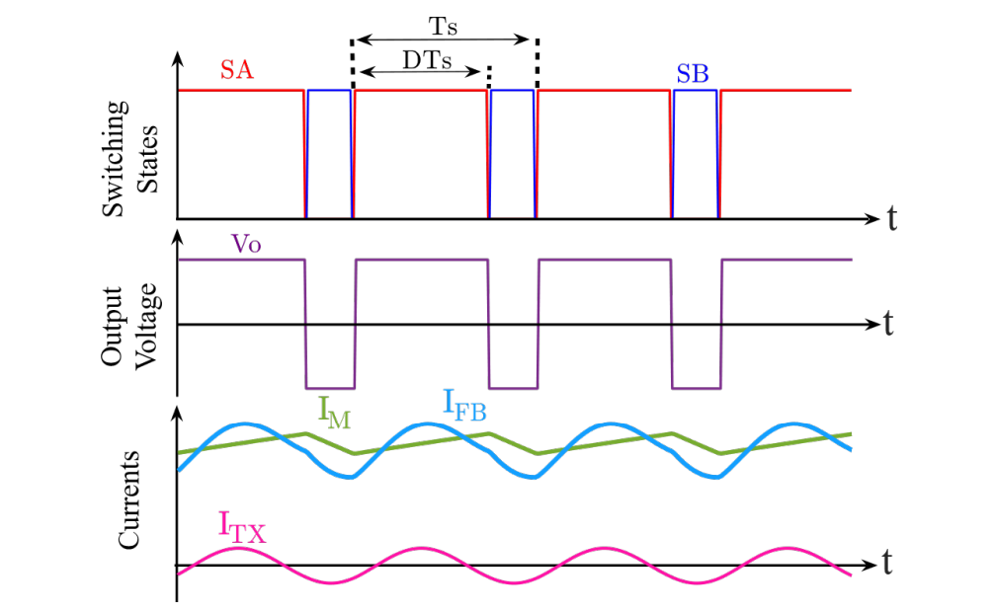
Proposed Control Method

Slide 22
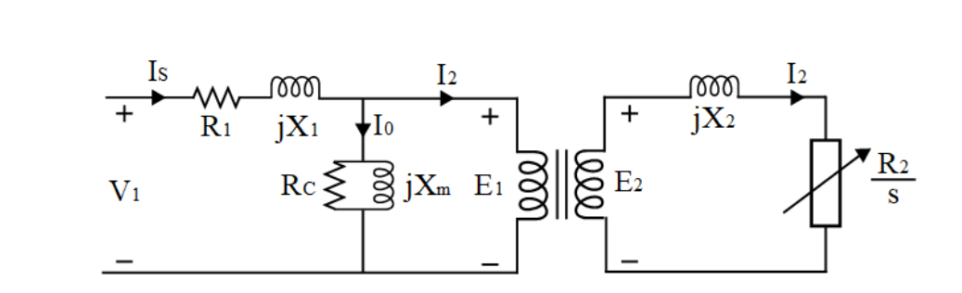
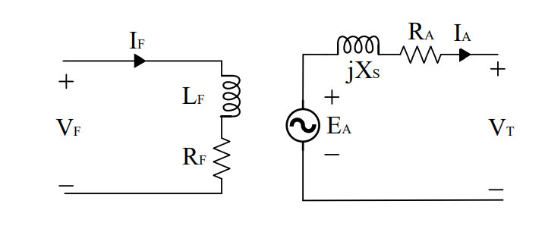
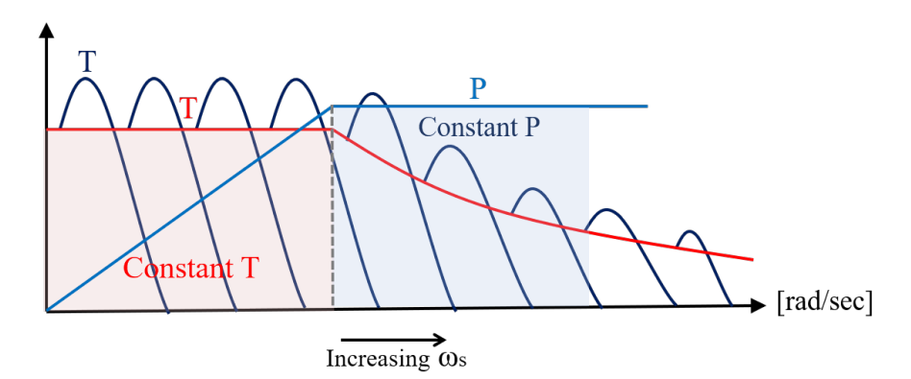
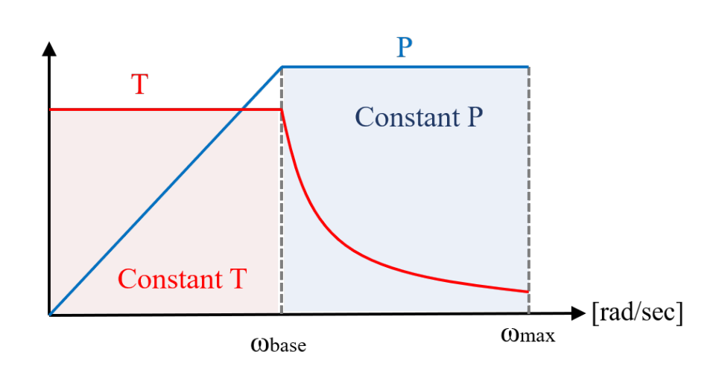
AC Motor Drives
Induction motor
Synchronous motor
Varying armature voltage and frequency

Slide 23
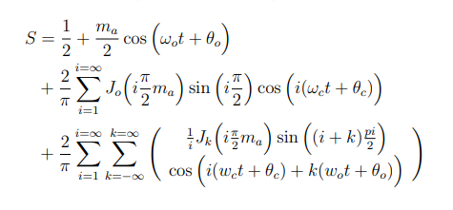
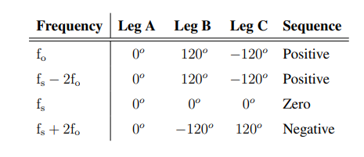
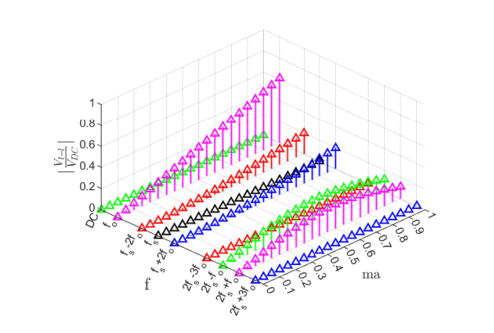
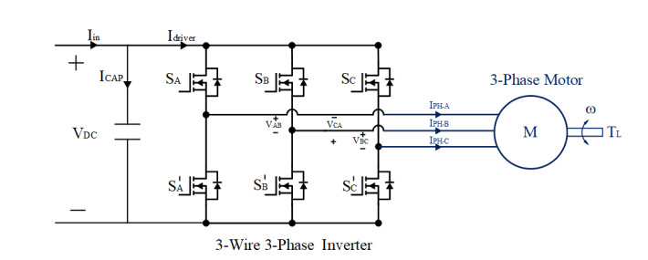
Conventional Modulation Technique

Slide 24
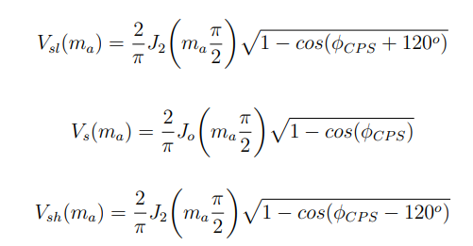
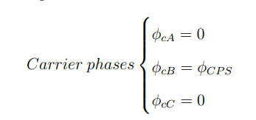
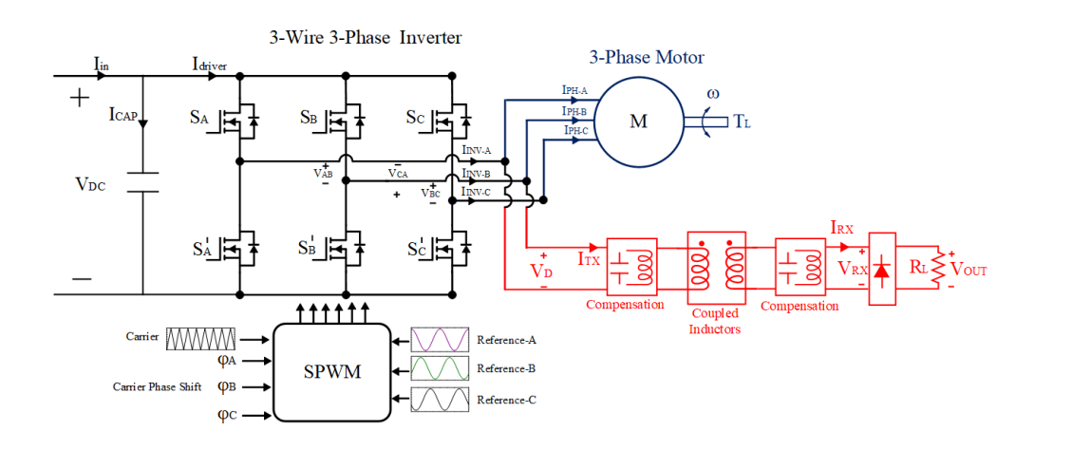
Proposed Modulation Technique

Slide 25
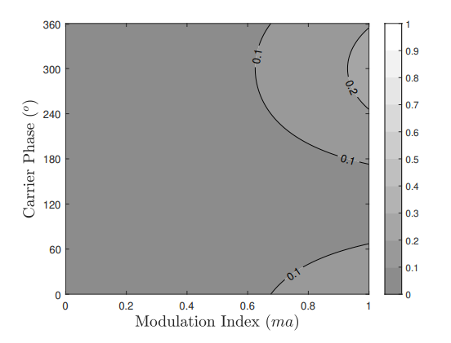
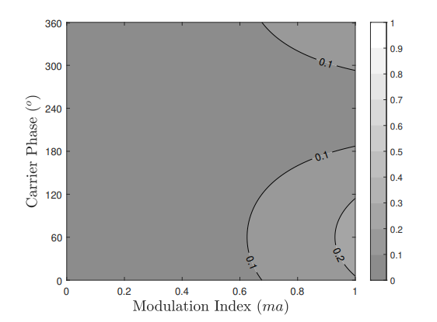
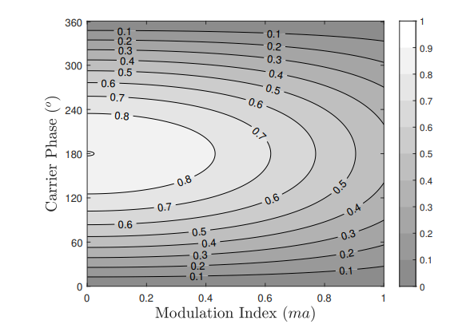
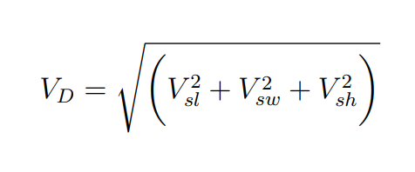
Proposed Modulation Technique

Slide 26


Proposed Control Method

Slide 27

Practical Considerations
require higher switching frequency
WPT systems
smaller coil sizes
require lower switching frequency
Motor
drives
to reduce
switching losses
Both requirements are provided GaN or SiC based motor drives

Slide 28
Outline
Aim of Study
Inductive Power Transfer System Basics
Theory Of Operations
Implementation for DC Motor
Implementation for AC Motor
Implementation for field excitation
Conclusion

Slide 29


System Overview and Experimental Setup

Slide 30










Wireless Power Transfer System Design
$$0.15 < D< 0.85$$
$40 V_{RMS}$< $V_{o,1^{st}}(rms)$< $90 V_{RMS}$
$$k$$

Slide 31


Wireless Power Transfer System Design

Slide 32


Coil Design

Slide 33



Impedance Modelling and Control

Slide 34


Experimental Results- WPT System Validation

Slide 35



Experimental Results - Concurrent Operation

Slide 36

Experimental Results – Loss and Efficiency

Slide 37

Experimental Results – Transient Load Changes

Slide 38

Experimental Results – Different Operating Conditions

Slide 39
Outline
Aim of Study
Inductive Power Transfer System Basics
Theory Of Operations
Implementation for DC Motor
Implementation for AC Motor
Implementation for field excitation
Conclusion

Slide 40



System Overview and Experimental Setup

Slide 41


Experimental Results- Carrier Phase Shift Validation

Slide 42









Wireless Power Transfer System Design

Slide 43


Wireless Power Transfer System Design

Slide 44
Experimental Results- WPT System Validation

Slide 45

Experimental Results - Concurrent Operation

Slide 46


Experimental Results – Variable Carrier Phase Shify

Slide 47


Experimental Results – Transient Load Changes

Slide 48
Outline
Aim of Study
Inductive Power Transfer System Basics
Theory Of Operations
Implementation for DC Motor
Implementation for AC Motor
Implementation for field excitation
Conclusion

Slide 49



System Overview and Experimental Setup

Slide 50







Wireless Power Transfer System Design

Slide 51


Experimental Validation- Carrier Phase Shift

Slide 52




New real-time algorithm

Slide 53



New real-time algorithm

Slide 54




New real-time algorithm
$${\hat{S}}_{AB_{fs}}=0.43 !$$

Slide 55


Experimental Validation- Carrier Phase Shift

Slide 56
Outline
Aim of Study
Inductive Power Transfer System Basics
Theory Of Operations
Implementation for DC Motor
Implementation for AC Motor
Implementation for field excitation
Conclusion

Slide 57

Performance Comparisons

Slide 58


Performance Comparisons

Slide 59
Contributions
A cost-efficient and simple-to-implement contactless slip ring is introduced.
For DC motor drives, a multi-frequency approach is presented to implement with a conventional DC motor PWM technique.
An independent control scheme, which comprises frequency and duty cycle control, is proposed for concurrent DC and high-frequency AC power transfer to the motor and rotating loads, respectively.
For AC motor drives, a multi-frequency approach is presented to implement with a conventional AC motor PWM technique.
An independent control scheme, which comprises carrier phase shift and modulation index control, is proposed for concurrent low-frequency AC and high frequency AC power transfer to the motor and slip rings, respectively.
For field excitation of the synchronous motors, a brushless slip ring is proposed to directly integrate into the motor drive with light-weight on the rotating side.
A novel real-time carrier-phase-shift calculation algorithm embedded in the motor control loop is developed to avoid low-frequency ripples stemming from the sideband harmonics.

Slide 60
Future Works
Improved coil design.
Capacitorless (Light-weight rotating side) WPT topologies.
Multi-phase WPT system.
Closed loop control, and current estimation algorithms.

Slide 61
Thanks!

